Slide 1
GYM LOCATER AND BOOKING

Slide 2
OBJECTIVE
Gym locator and booking is an online platform, which helps manage membership bookings, location, various offers and contact of Gym faculty member etc.
It provides a self-service kiosk through which you can find the location of gym, complete your booking process for best gym, for a track the location of best gym, plan your diet and schedule and keep them updated through this platform.

Slide 3
DATA FLOW CHART

Slide 4
MODULES
Spring Boot
Hibernate
Thymeleaf
HTML
CSS
Bootstrap
MySQL
JavaScript
jQuery

Slide 5
SPRING BOOT
Spring Boot is an open source Java-based framework used to create a micro Service.
It is developed by Pivotal Team and is used to build stand-alone and production ready spring applications.
Spring Boot provides a good platform for Java developers to develop a stand-alone and production-grade spring application that you can ”just run”.
You can get started with minimum configurations without the need for an entire Spring configuration setup.

Slide 6
HIBERNATE
Hibernate is primary feature is mapping from Java classes to database tables, and mapping from Java data types to SQL data types.
Hibernate also provides data query and retrieval facilities.
It generates SQL calls and relieves the developer from the manual handling and object conversion of the result set.

Slide 7
THYMELEAF
Thymeleaf is a Java XML/XHTML/HTML5 template engine that can work both in web (servlet-based) and non-web environments.
It is better suited for serving XHTML/HTML5 at the view layer of MVC-based web applications, but it can process any XML file even in offline environments.

Slide 8
MYSQL
MySQL is released under an open-source license. So you
have nothing to pay to use it.
MySQL is a very powerful program in its own right. It
handles a large subset of the functionality of the most
expensive and powerful database packages.
MySQL uses a standard form of the well-known SQL data language.
MySQL works on many operating systems and with many languages including PHP, PERL, C, C++, JAVA, etc.
MySQL works very quickly and works well even with large data sets.

Slide 9
HTML
HTML definition is Hyper Text Markup Language and it is a markup language.
A markup language is a set of markup tags and the tags describe document content. HTML documents contain HTML tags and plain text.
HTML documents are also called web pages.
HTML markup tags are usually called HTML tags and tags are keywords surrounded by angle brackets like <html>.

Slide 10
CSS
Cascading Style Sheets, fondly referred to as CSS, is a simple design language intended to simplify the process of making web pages presentable.
CSS handles the look and feel part of a web page.
Using CSS, you can control the color of the text, the style of fonts, the spacing between paragraphs, how columns are sized and laid out, what background images or colors are used,

Slide 11
BOOTSTRAP
Bootstrap is a free and open-source CSS framework directed at responsive, mobile-first front-end web development.
It contains CSS- and JavaScript-based design templates for typography, forms, buttons, navigation, and other interface components.

Slide 12
FUTURE SCOPES
Future scope for gym locator and booking is that now a days peoples are very much worried about their physique so this portal will help them to search the nearest gym and also book them. So, there is no need to go out and search the gym. This will save their travelling and time. And also they can select the offer on the membership.

Slide 13
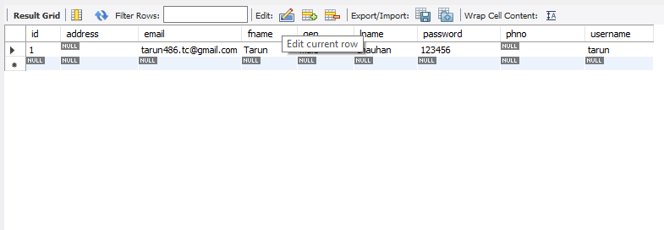
DATABASE TABLES
User Table:
Gym Table:

Slide 14
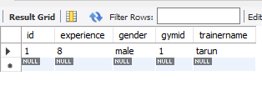
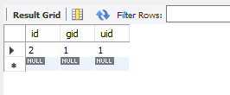
DATABASE TABLES
Booking Table:
Trainer Table:

Slide 15
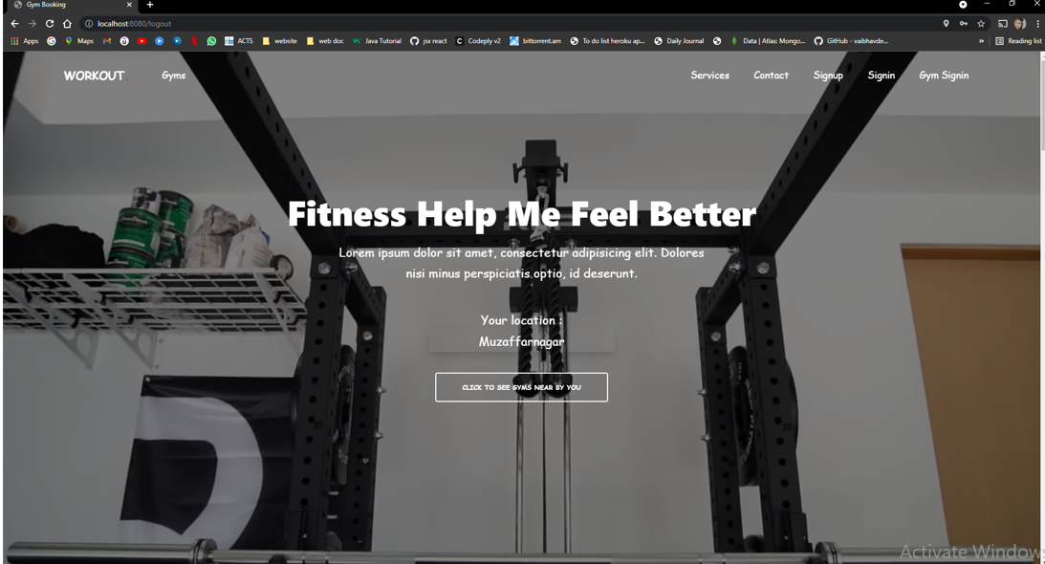
HOME PAGE

Slide 16
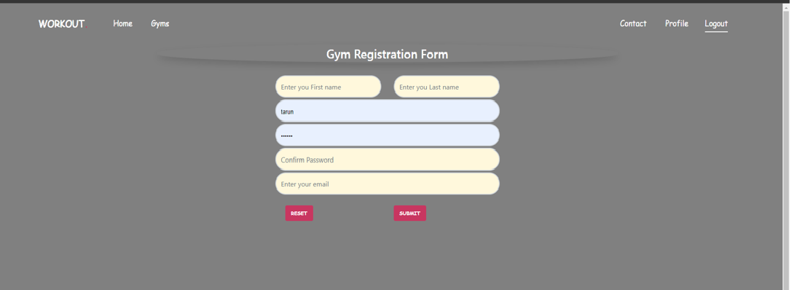
Gym Registration

Slide 17
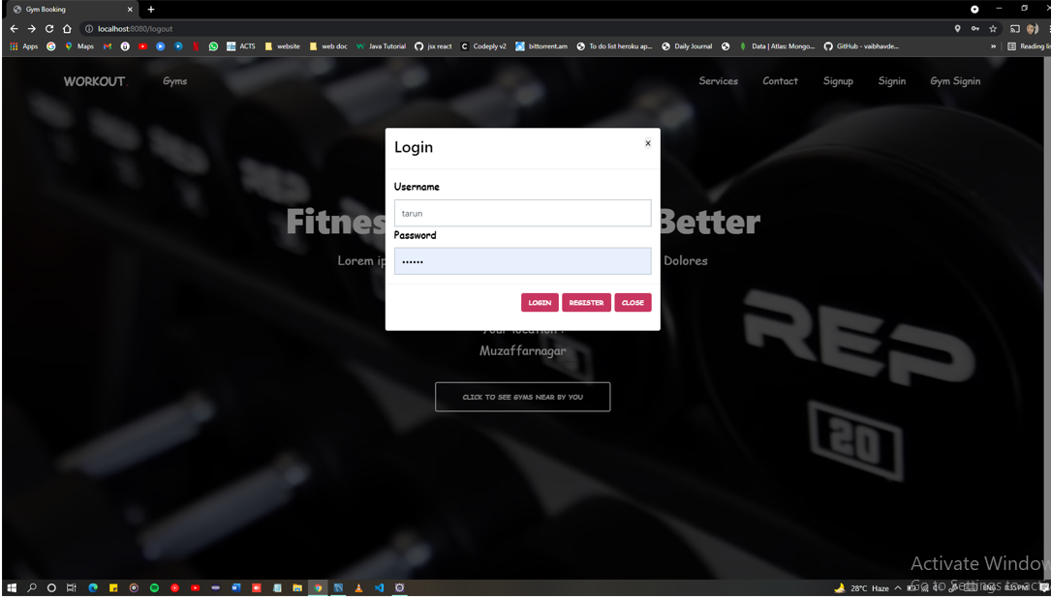
Gym Login

Slide 18
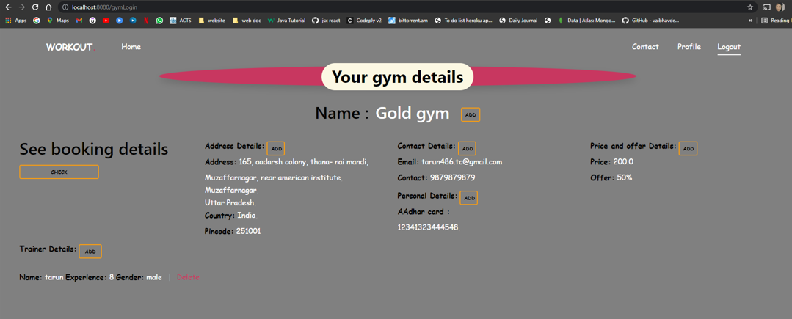
Gym Details

Slide 19
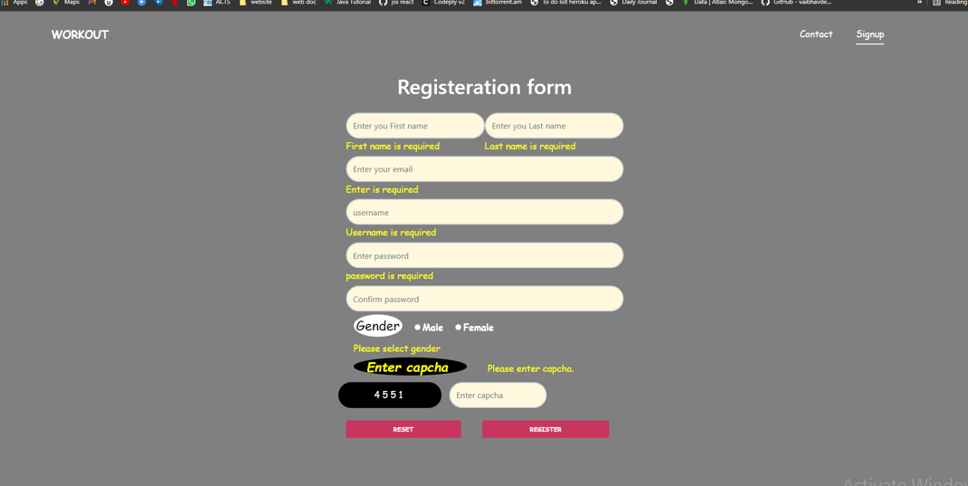
User Registration Page

Slide 20
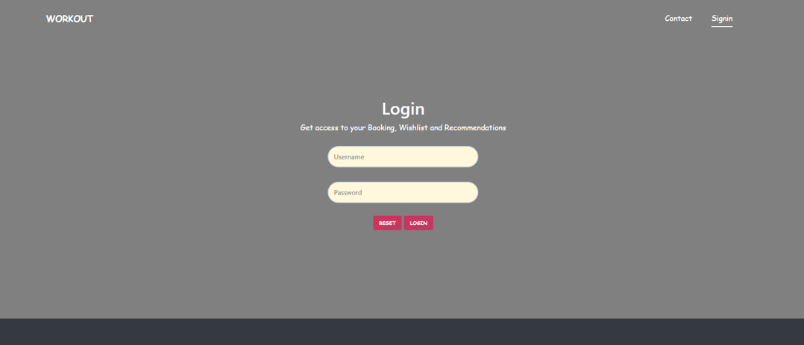
User Login

Slide 21
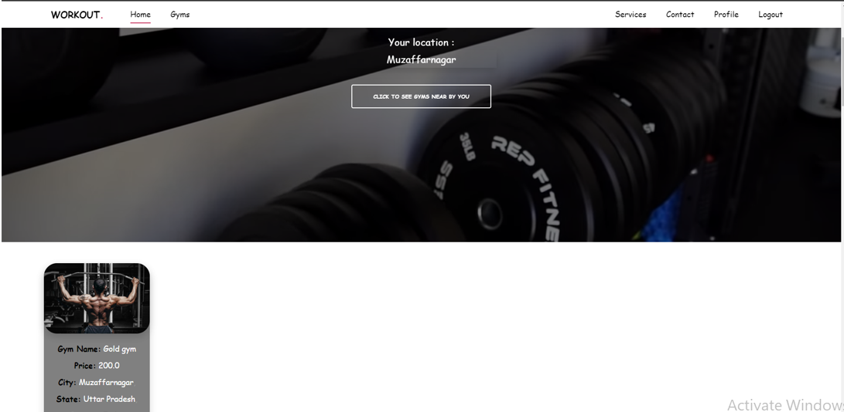
User Home

Slide 22
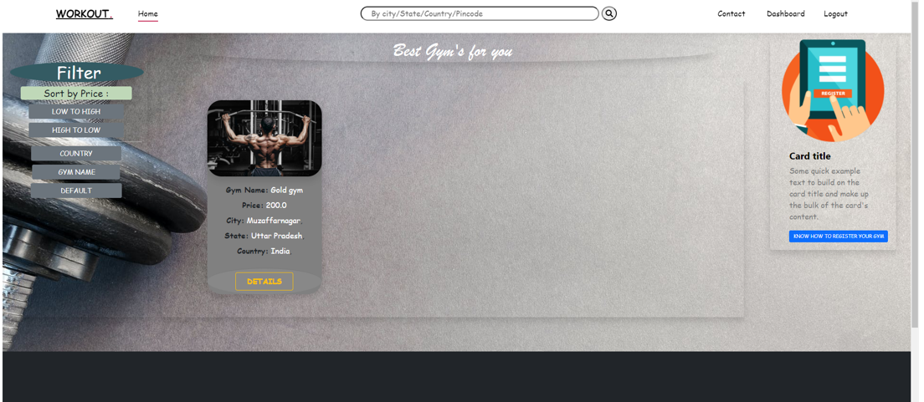
All Gyms

Slide 23
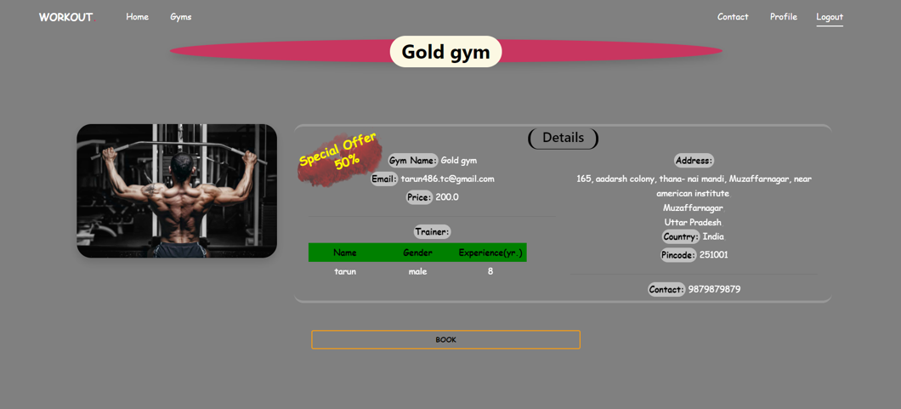
Selected gym details

Slide 24
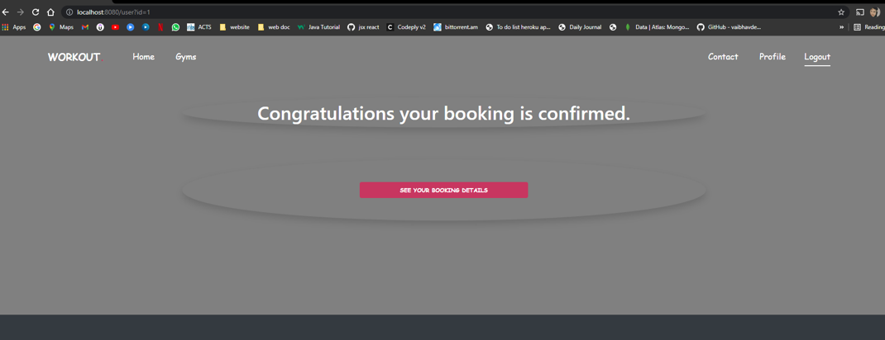
Booking confirmed

Slide 25
Cancel booking Page

Slide 26
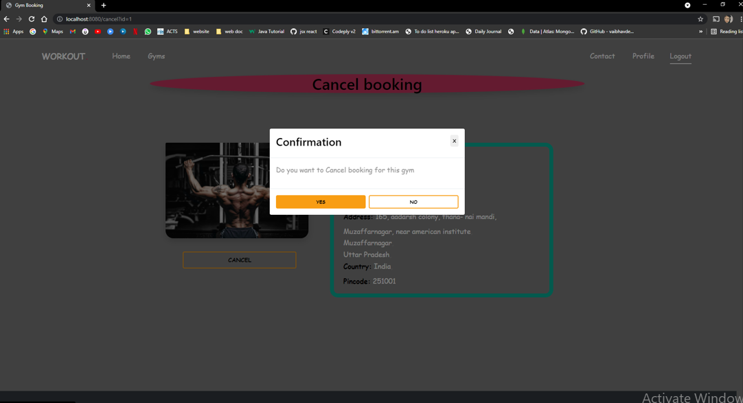
Cancel booking Confirmation

Slide 27
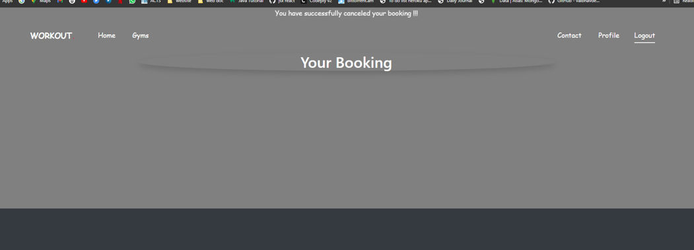
Booking

Slide 28
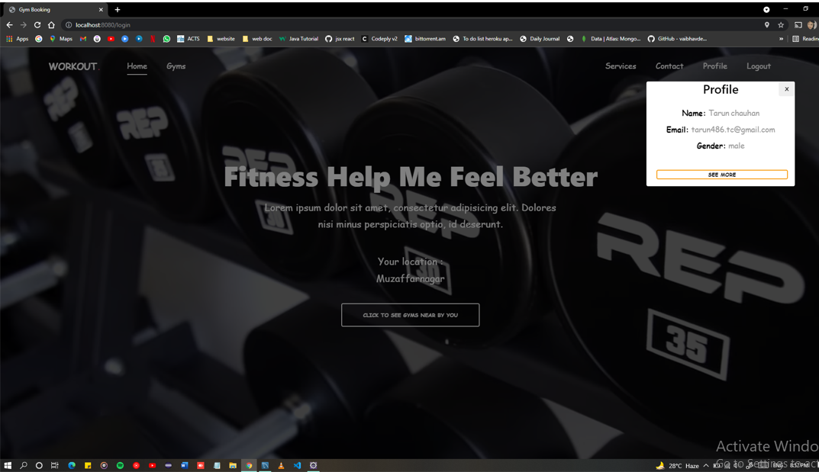
Gym Home Page

